Slide 1
JavaScript - JS
SE 3355 Web Development
Lect. Barış Ceyhan

Slide 2
Motivation
Make webpages interactive, modular
Client-side program in web pages
Only supported language in all browsers
Inspect when anything happens- there is most probably JS behind it
https://codepen.io/pen/

Slide 3
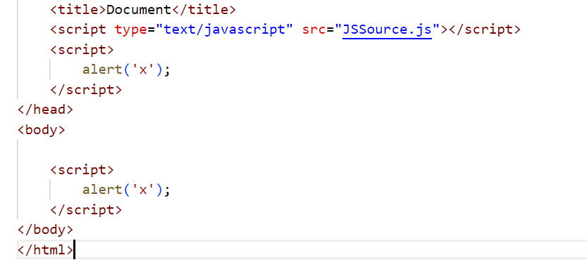
syntax
Where do you put the syntax?
internal-external
No html inside between <script></script>
Always remember – page is loaded TOP-DOWN
Using console

Slide 4
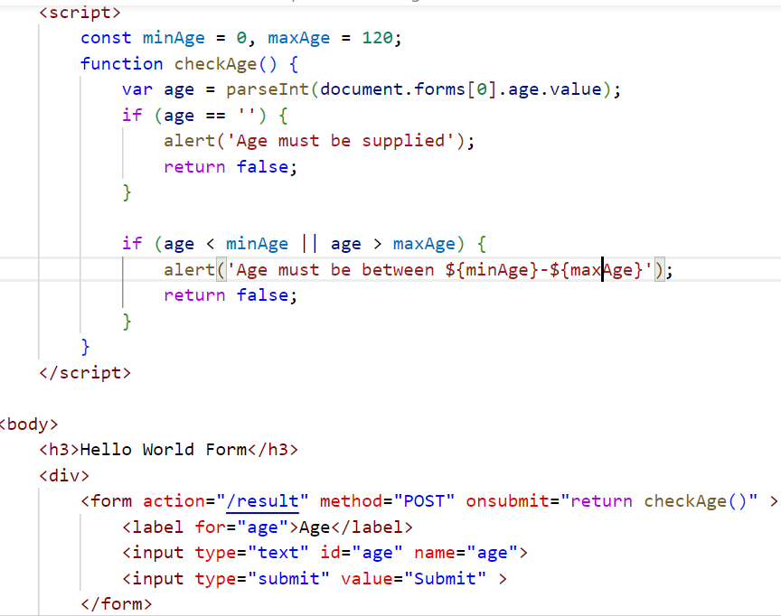
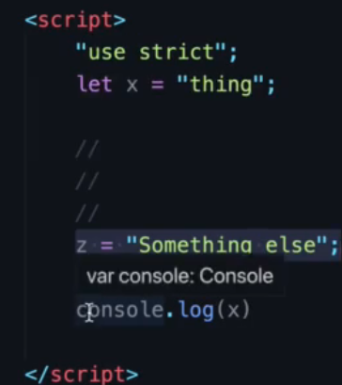
syntax, variables
If you know java, python any PL, JS is easy
Couple interesting points
let,const - scope is closest {}
Performance
https://www.freecodecamp.org/news/var-let-and-const-whats-the-difference/
var bumps it to the top??
Always prefer being strict? use strict.
More secure

Slide 5
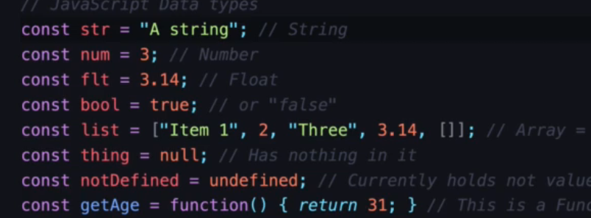
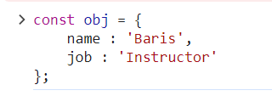
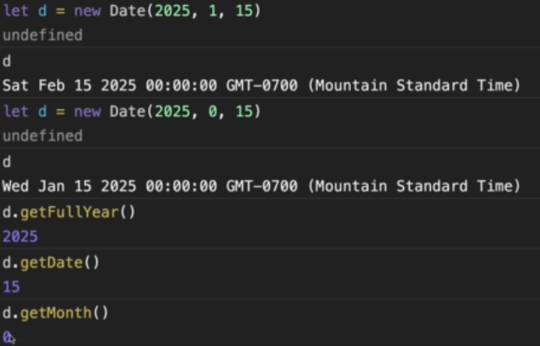
Data structures
list
Anonymous function
Key-value pairs
Use typeof
Dates
https://www.w3schools.com/js/js_date_methods.asp

Slide 6
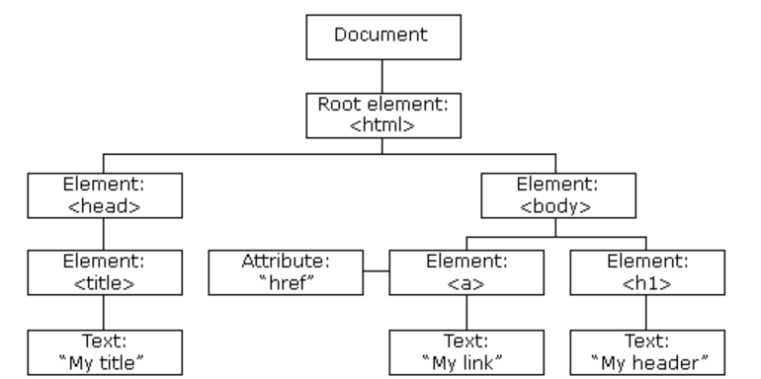
DOM – Document Object Model
Hierarchical model
Document.getElementById(‘id’);
Id to be unique

Slide 7
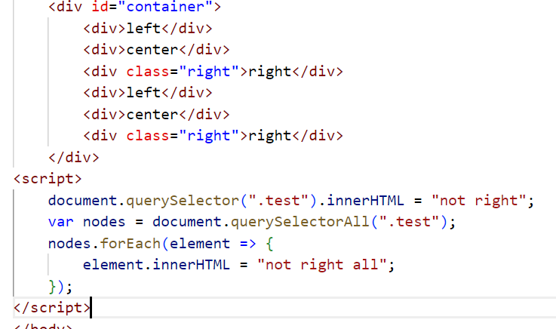
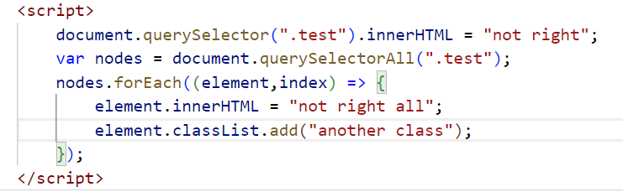
DOM selectors
Document.querySelector to select single
querySelectorAll to select multiple DOM objects

Slide 8
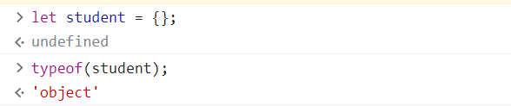

Objects - strings
Create an object. Good to define a variable with structure
Use of this
let obj = {
name : 'Baris',
age : 30,
calcGpa(year=2023) {
console.log(this.name);
}
};

Slide 9
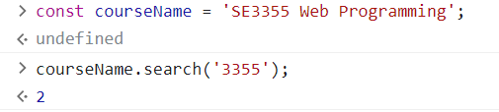

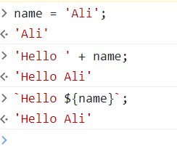
String – an object as well
length,search, slice, substr, replace, toUpperCase, toLowerCase, split (important)
Array access
Concat – the right way
Backtick for template literals
https://www.w3schools.com/js/js_string_methods.asp

Slide 10
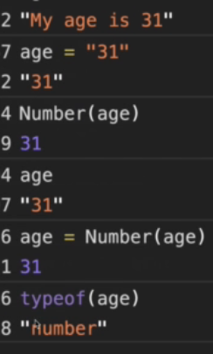
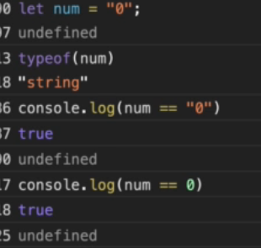

Data type casting
Loosely typed language
Arrays and objects cannot be case
Number, Array, Boolean
All inputs are string, always convert to right type when programming
Strict comparison – compare type and value

Slide 11
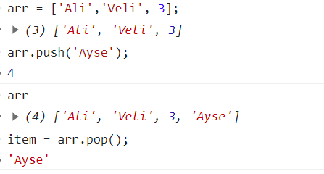
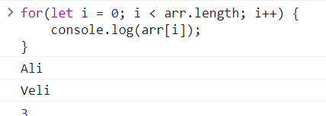
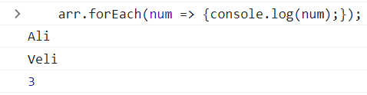
Arrays
push, pop
Iterate old school, new school

Slide 12
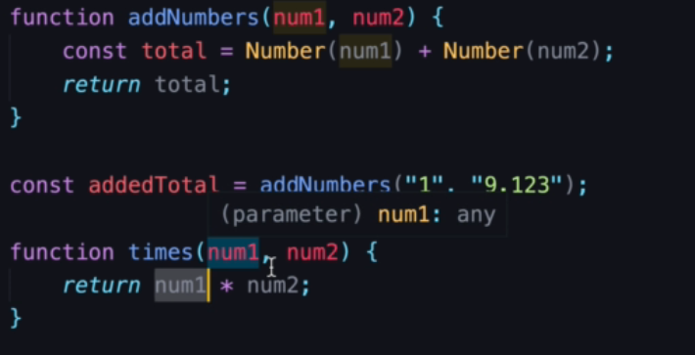
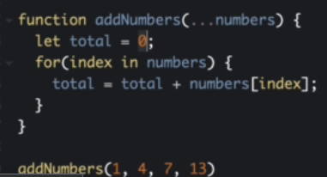
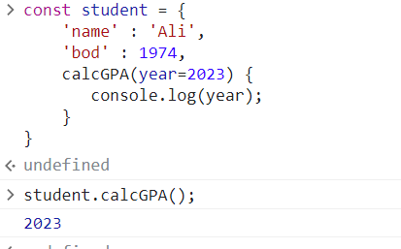
Functions - DRY
DRY as in other PLs
https://www.linkedin.com/pulse/best-practices-writing-javascript-code-dry-kiss-yagni-emmanuel/
Rest operator (…numbers)
Objects with functions . Used a lot in templates, frameworks

Slide 13
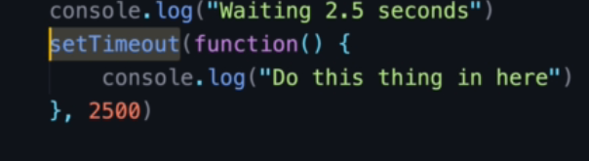
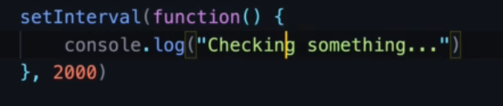
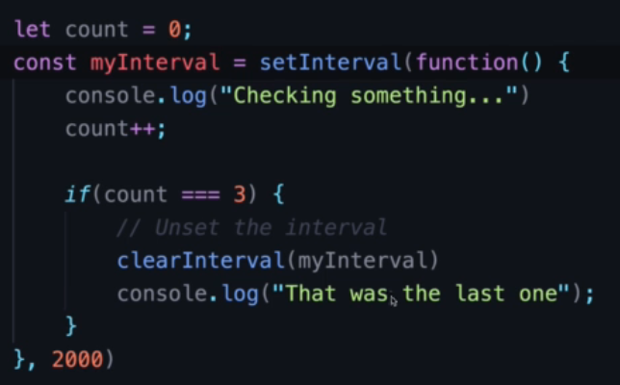
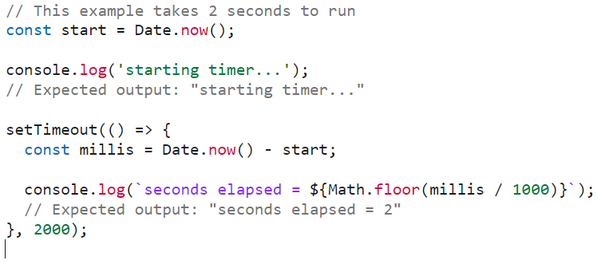
Functions
Callback functions – delayed
setTimeout
Interval functions – runs at given interval
setInterval

Slide 14
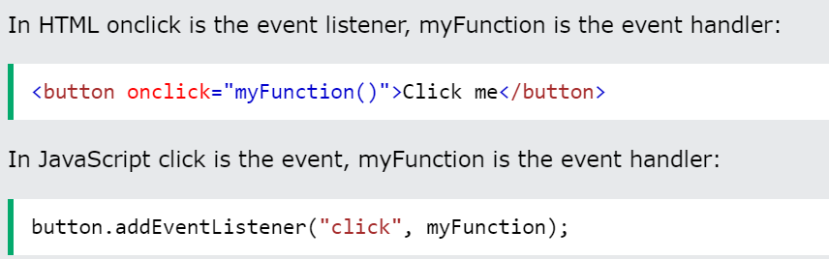
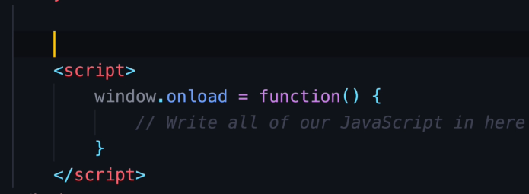
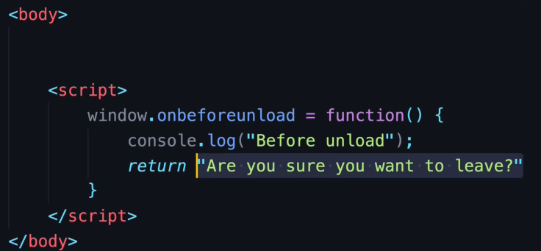
Events When to run JS
DOM Events allow JavaScript to add event listener or event handlers to HTML elements.
Remember all events
https://www.w3schools.com/JSREF/dom_obj_event.asp
After page is loaded
After moving out of the page

Slide 15
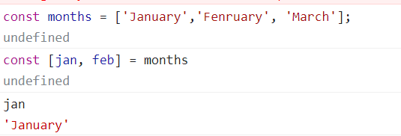
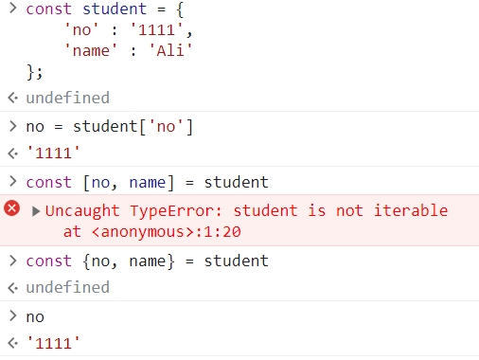
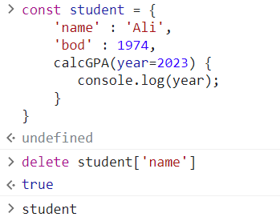
Destructuring arrays, objects
Some modern JS
Destructure arrays objects to avoid multi lines
Shortcut to object['attribute’]
Delete object attribute. Cant delete object. Try with strict?

Slide 16
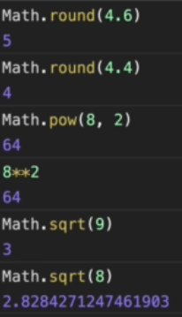
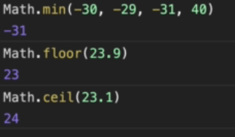
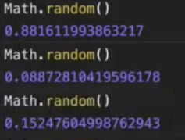
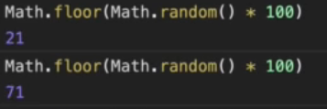
Math library
round,min, max, random
https://www.w3schools.com/js/js_math.asp

Slide 17
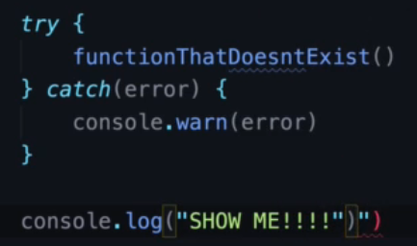
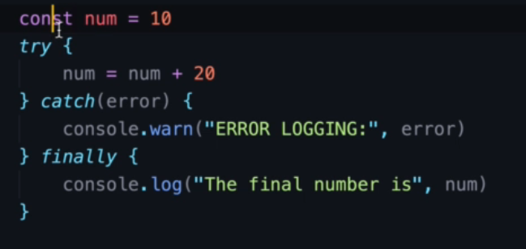
Try-catch
Rarely seen but helpful
Same java syntax
You can also throw custom
throw (“custom error“);

Slide 18
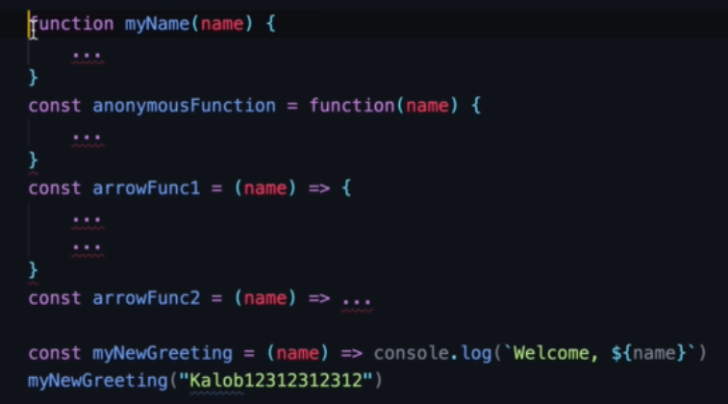
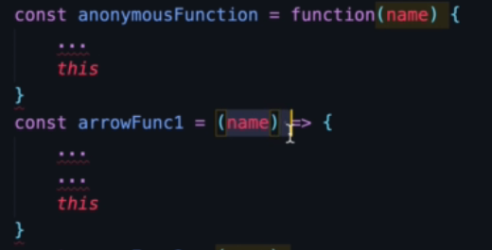
Functions in many ways
Old way
Arrow functions
this keyword works different here

Slide 19
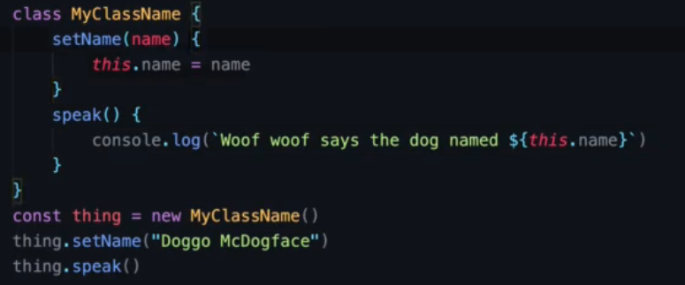
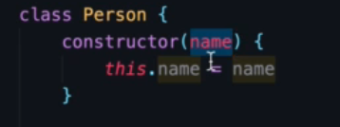
classes
Can do more than objects
Quite common
Usage of constructor

Slide 20
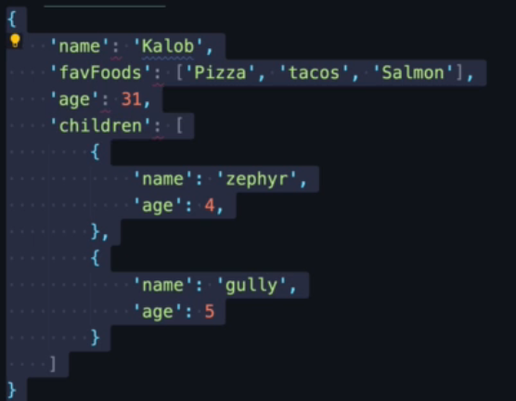
JSON – Javascript Object Notation
Format to get languages talking to each other.
Xml – old school
Node.js -> python
Used in APIs
Several libraries to convert to/from objects

Slide 21
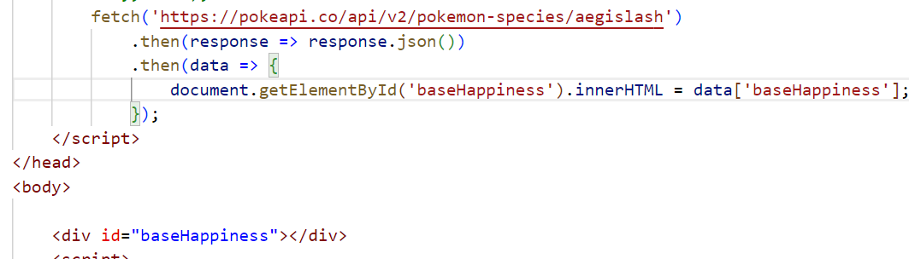
AJAX – Asynchronous JS and XML
XMLHttpRequest
Dynamic scroll without having to reload
It is lightweight, it return json object to lw request
Just data. No css, html
Use fetch() to fetch json data and deal with it i.e display in a list etc
Try it
https://swapi.dev/api/people/1
Show attributes of a star wars character

Slide 22
resources
https://developer.mozilla.org/en-US/docs/Web/JavaScript
https://goalkicker.com/JavaScriptBook/JavaScriptNotesForProfessionals.pdf
Nice professional reference

